Slide 1




Data Science HACKATHON
[RAINFALL ANALYSIS IN GHANA]
[Data Hackers]

Slide 2
[Problem Statement]
Rainfall is of great importance to Ghana whose economy is largely dependent on agriculture.
However, rainfall is the cause of natural disasters like flooding.
Flooding has lead to the loss of lives and properties.

Slide 3
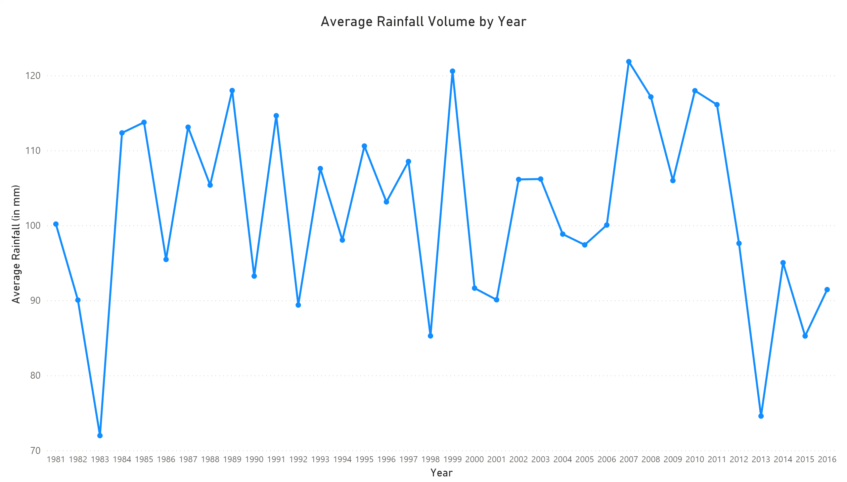
[Data Findings]

Slide 4
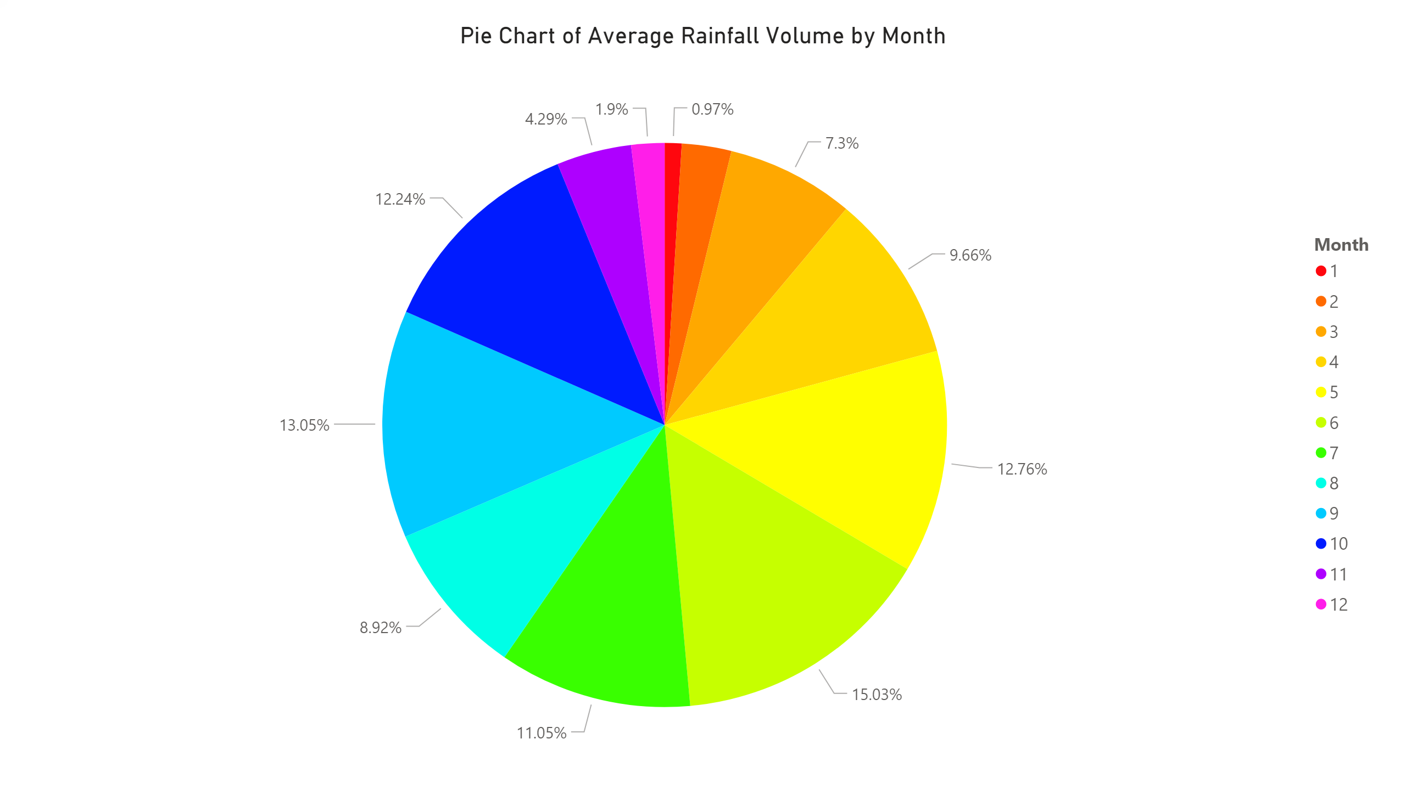
[Data Findings]
#

Slide 5
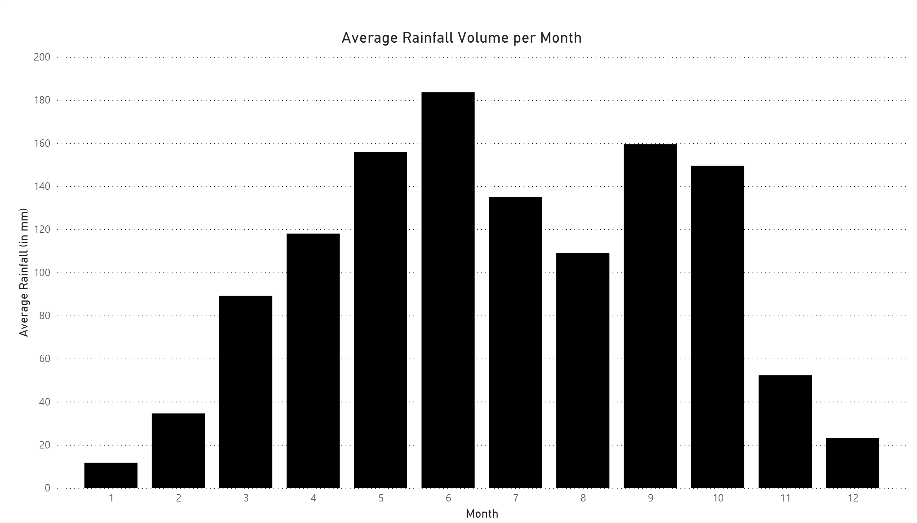
[Data Findings]
#

Slide 6
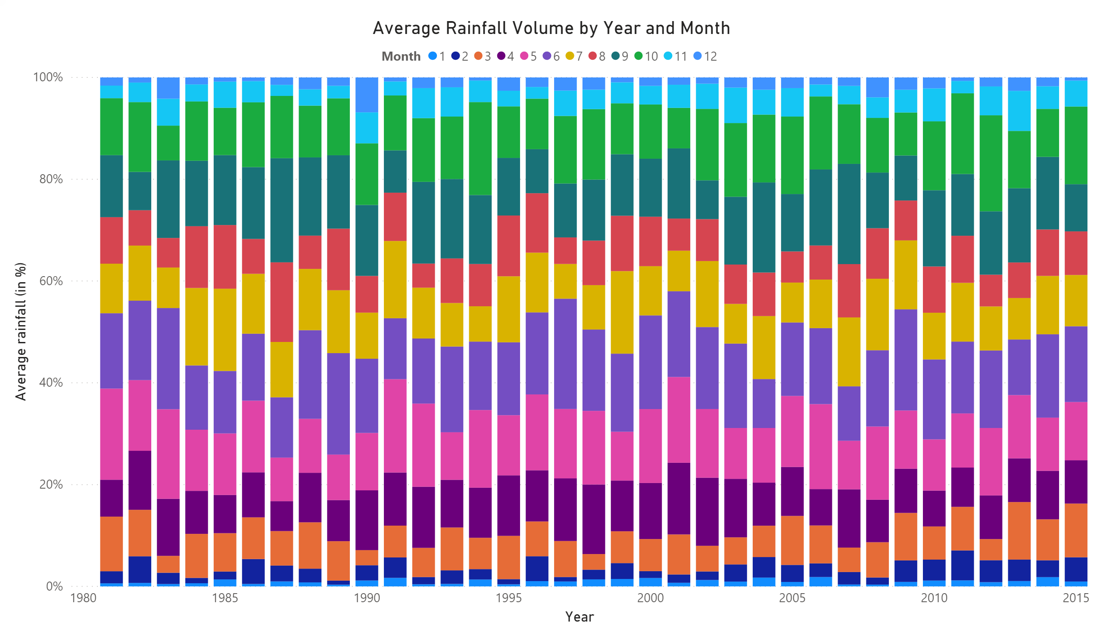
[Data Findings]
#

Slide 7
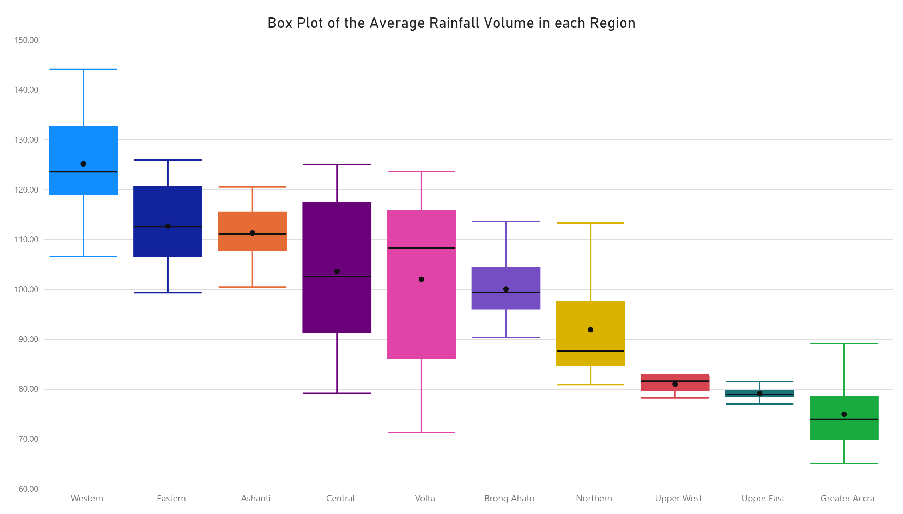
[Data Findings]
#

Slide 8
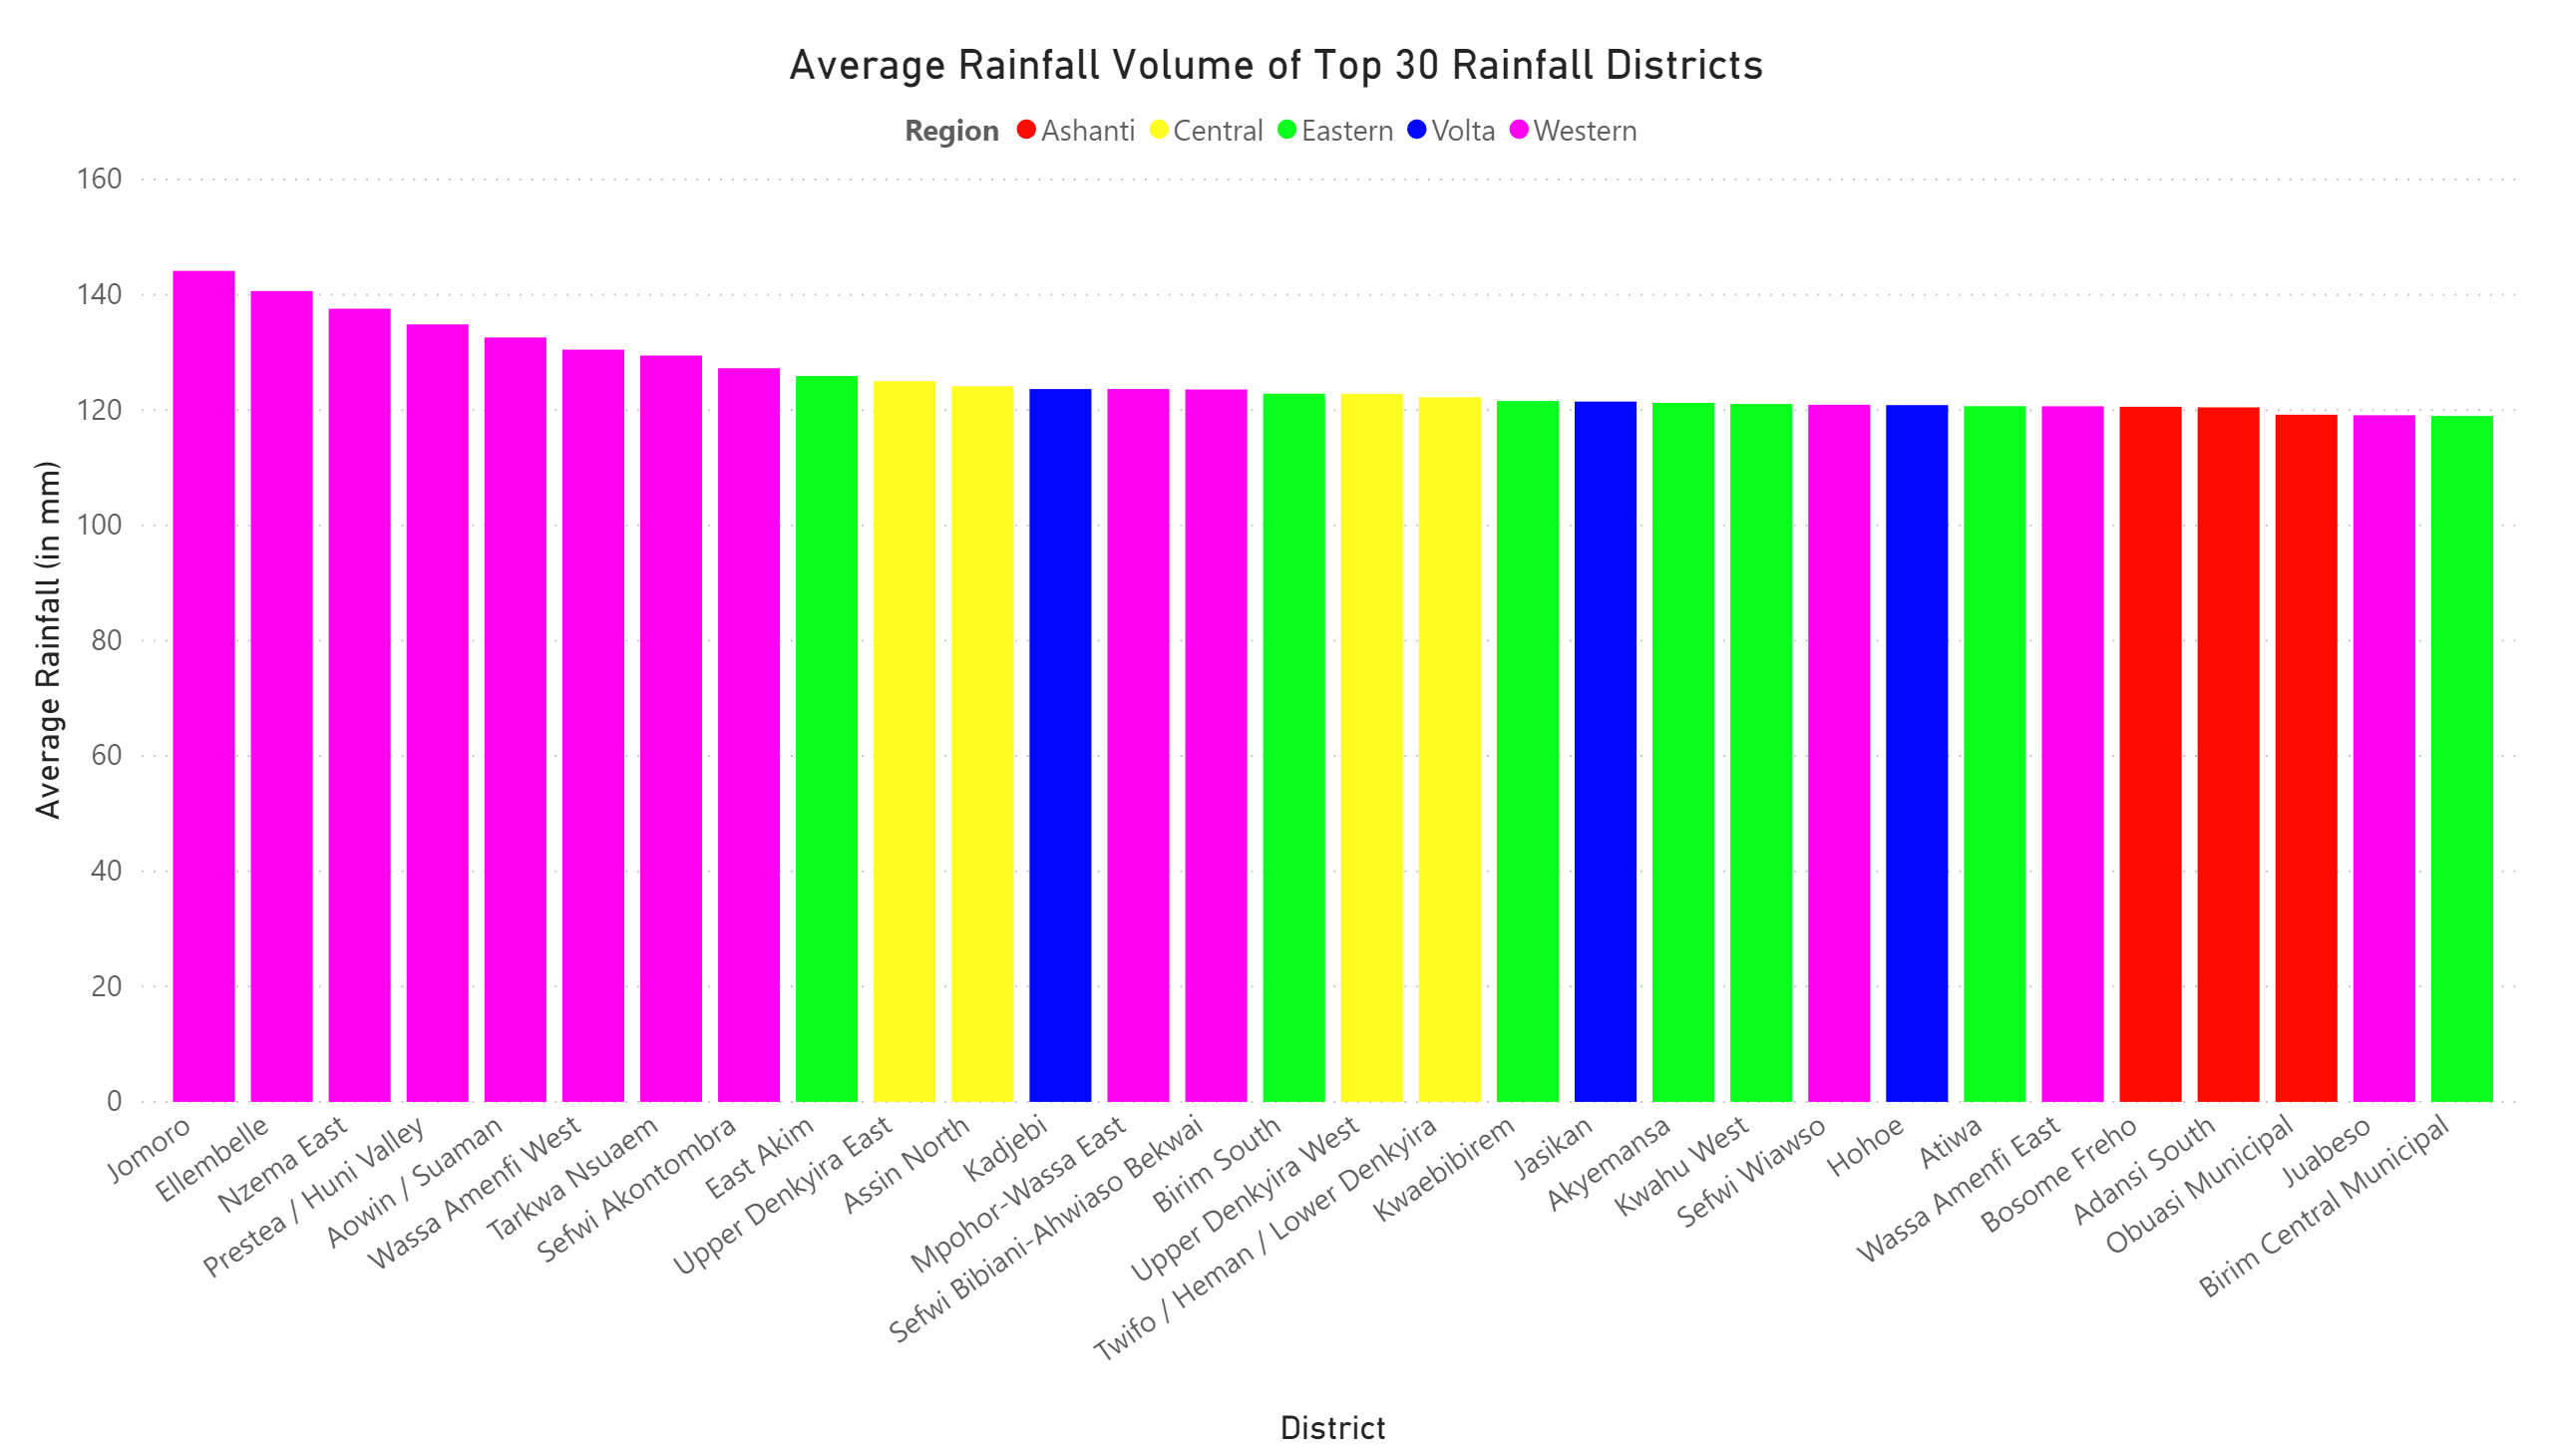
[Data Findings]

Slide 9
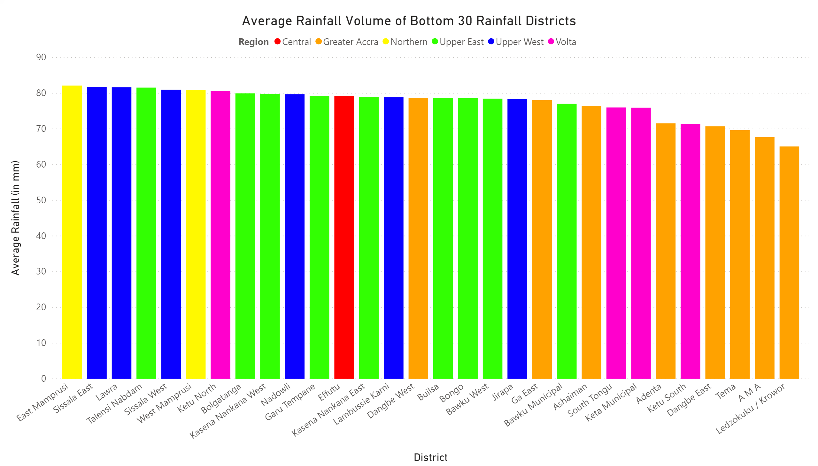
[Data Findings]
#

Slide 10
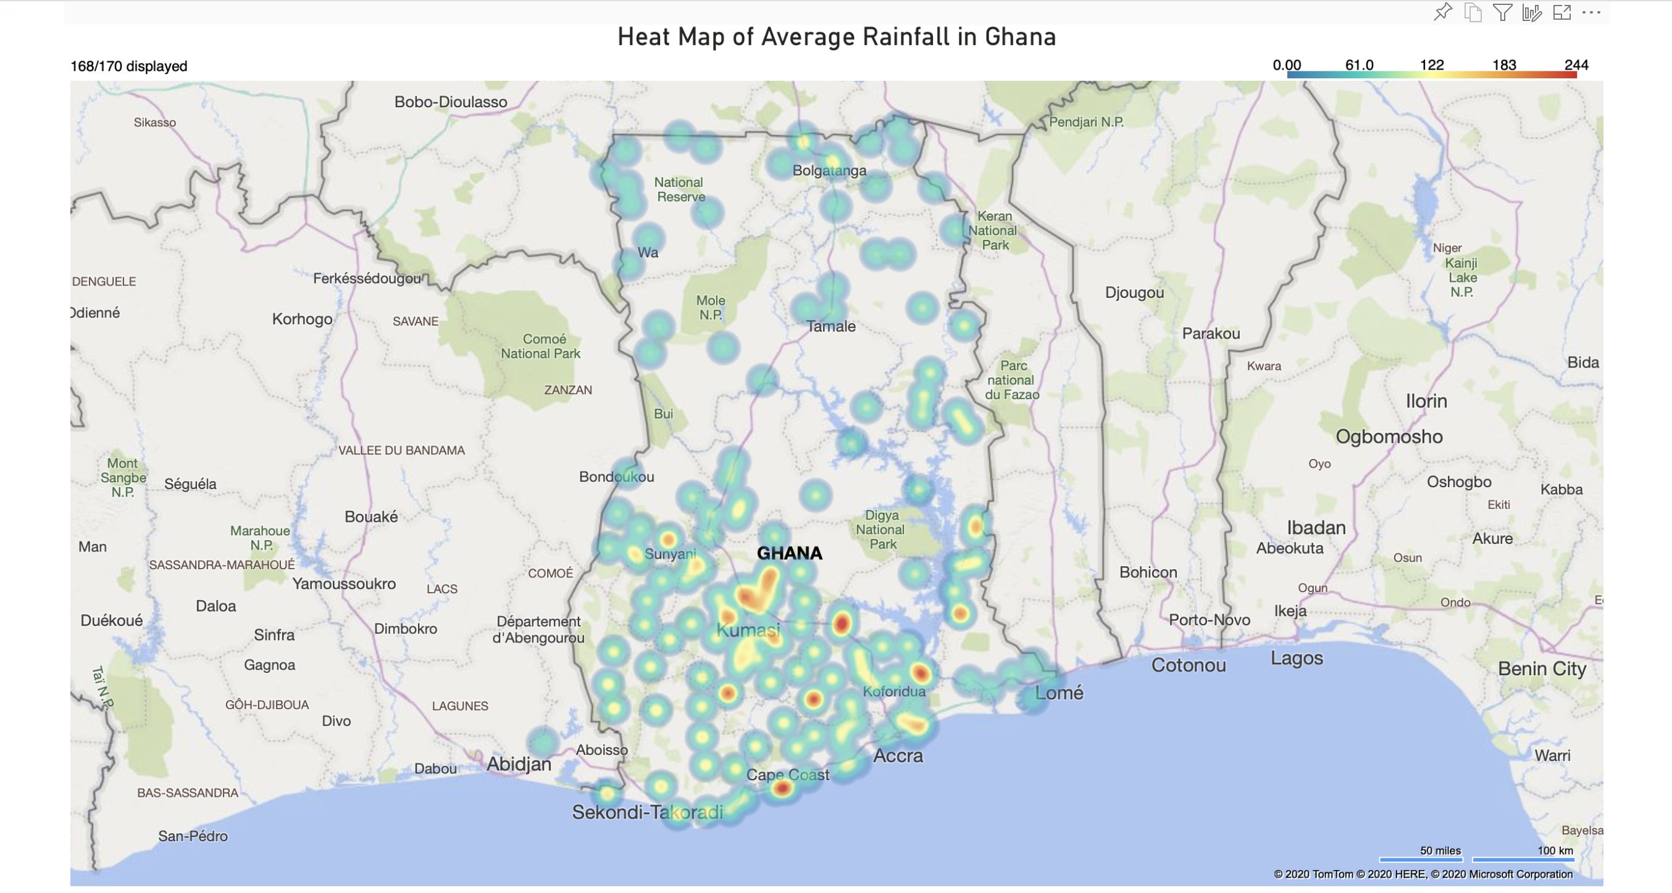
[Data Findings]

Slide 11
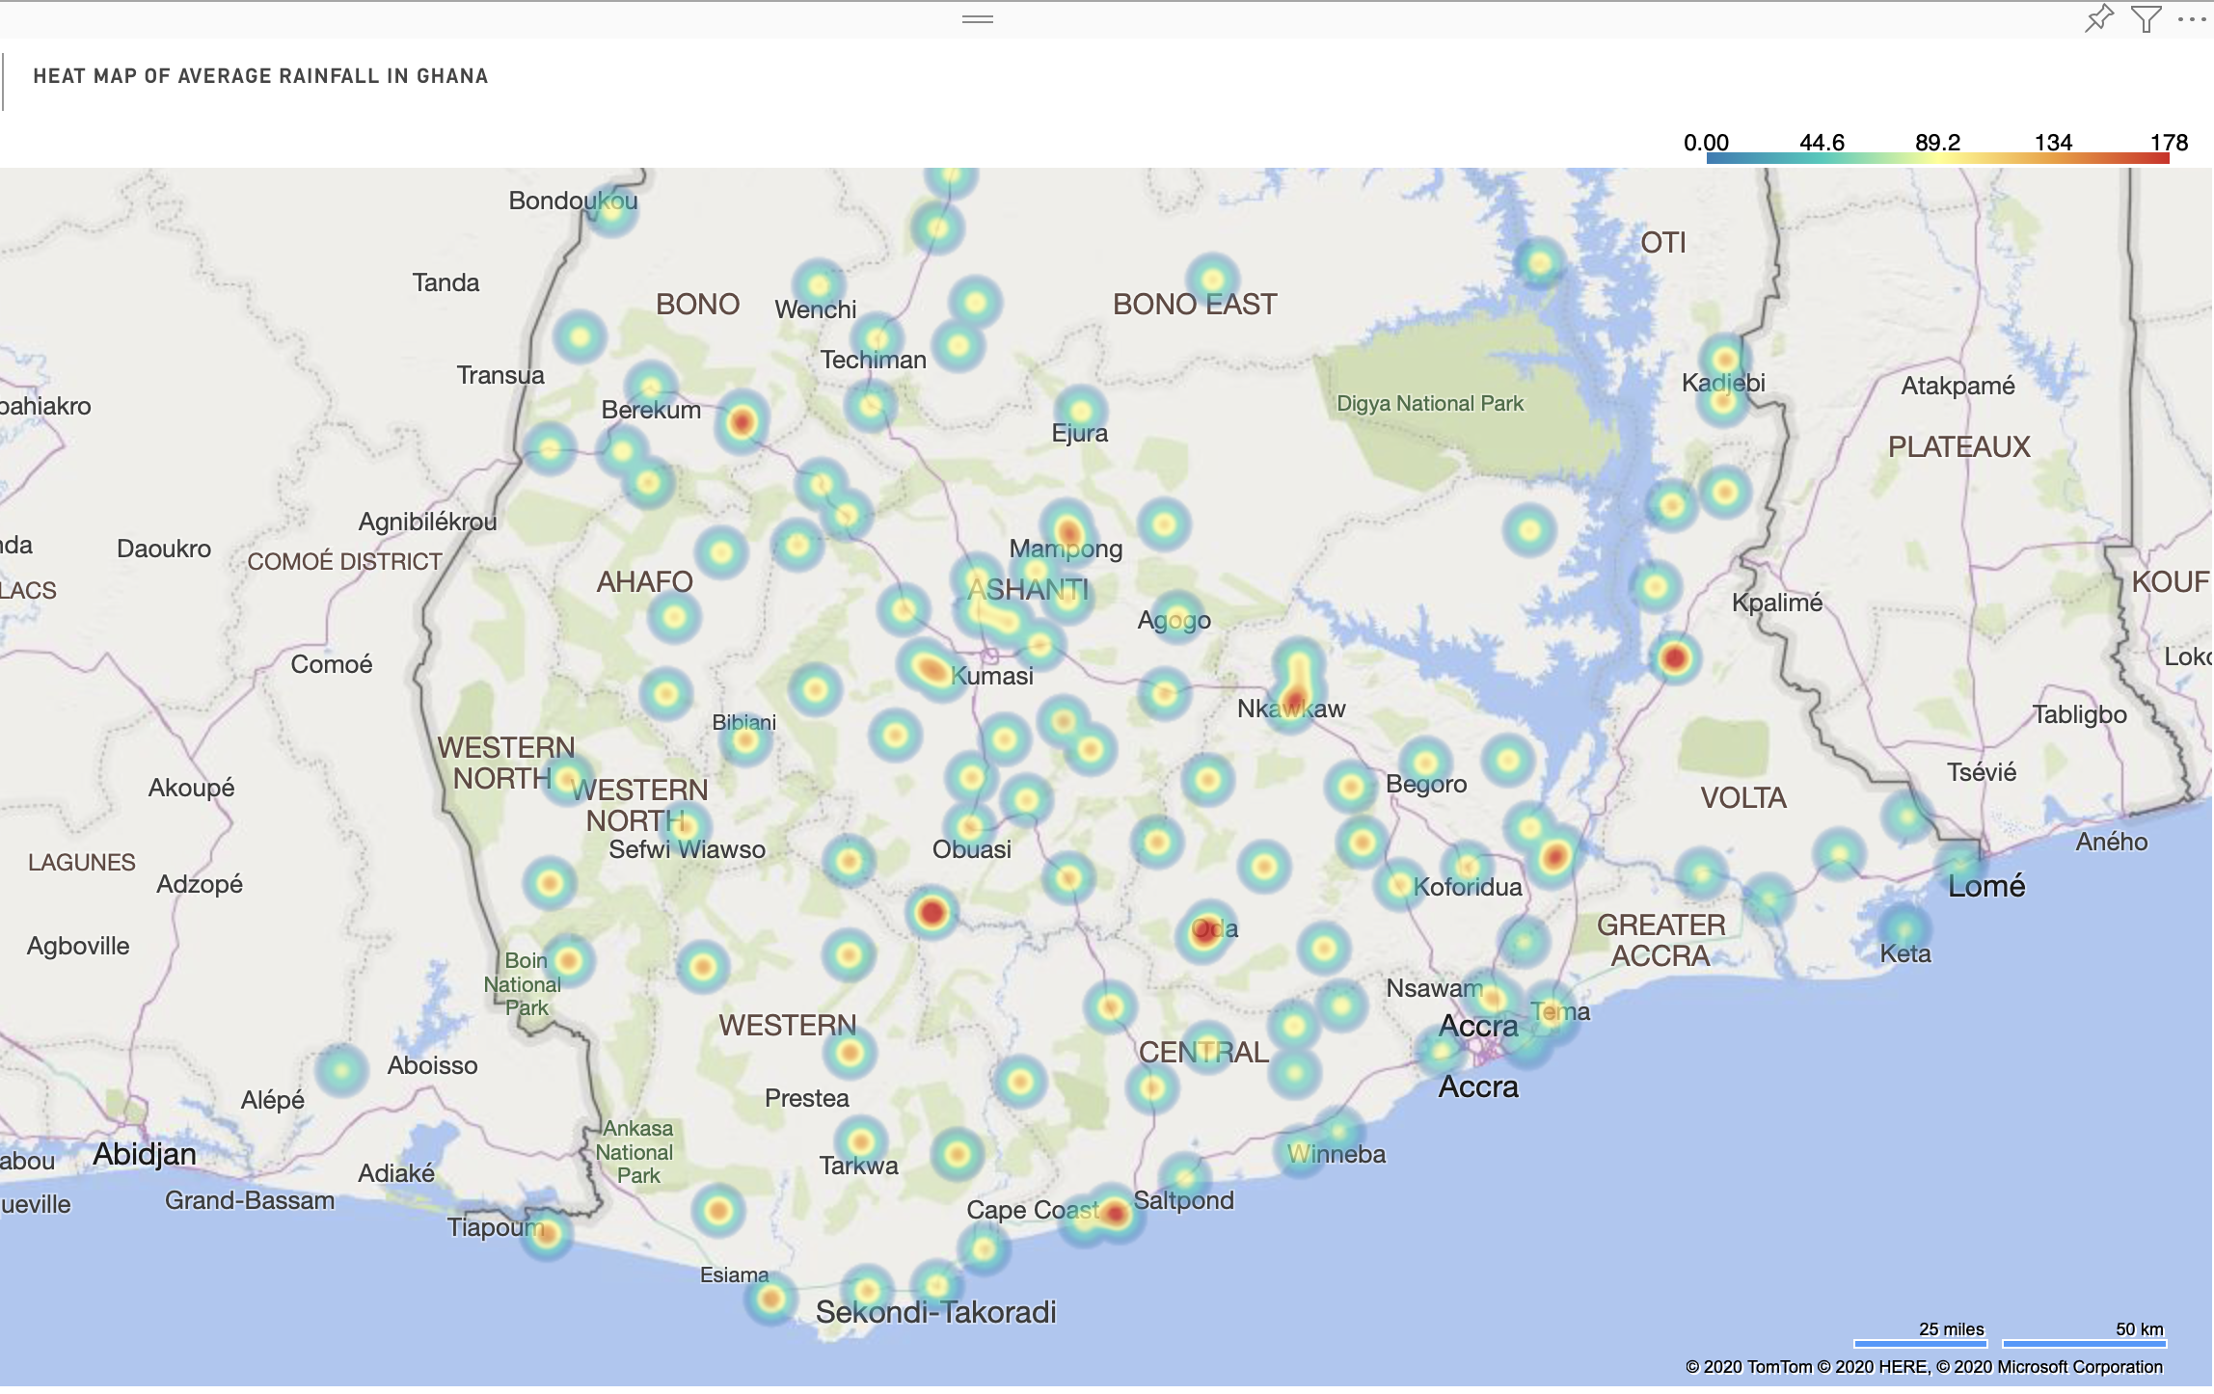

Slide 12
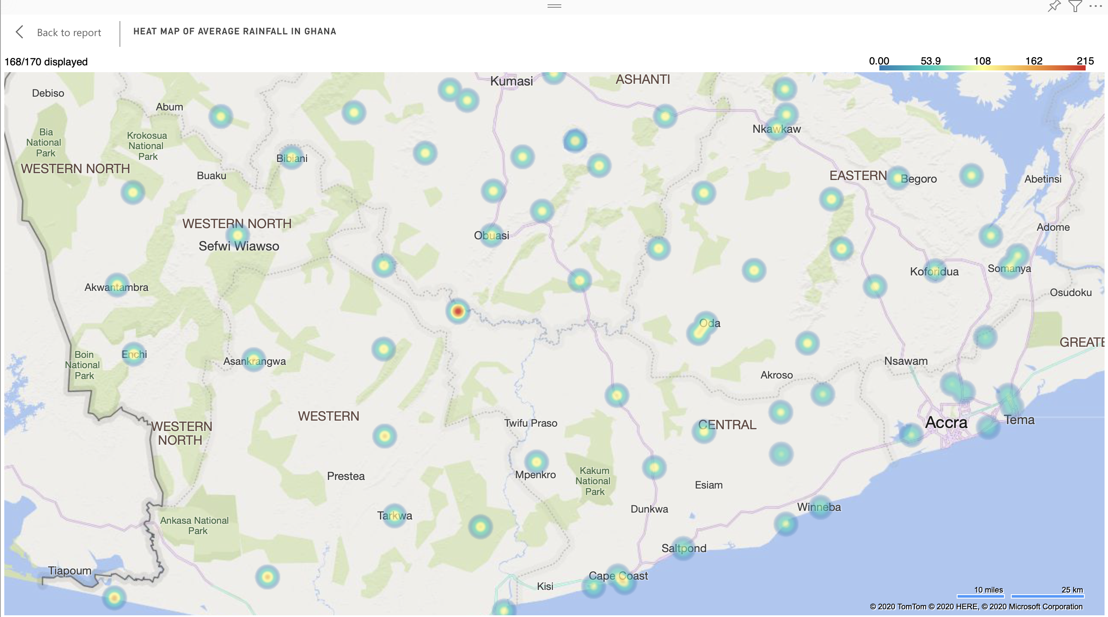

Slide 14
[Implications]
Does High Rainfall Volume In a Region/District Lead To Floods?
#

Slide 15
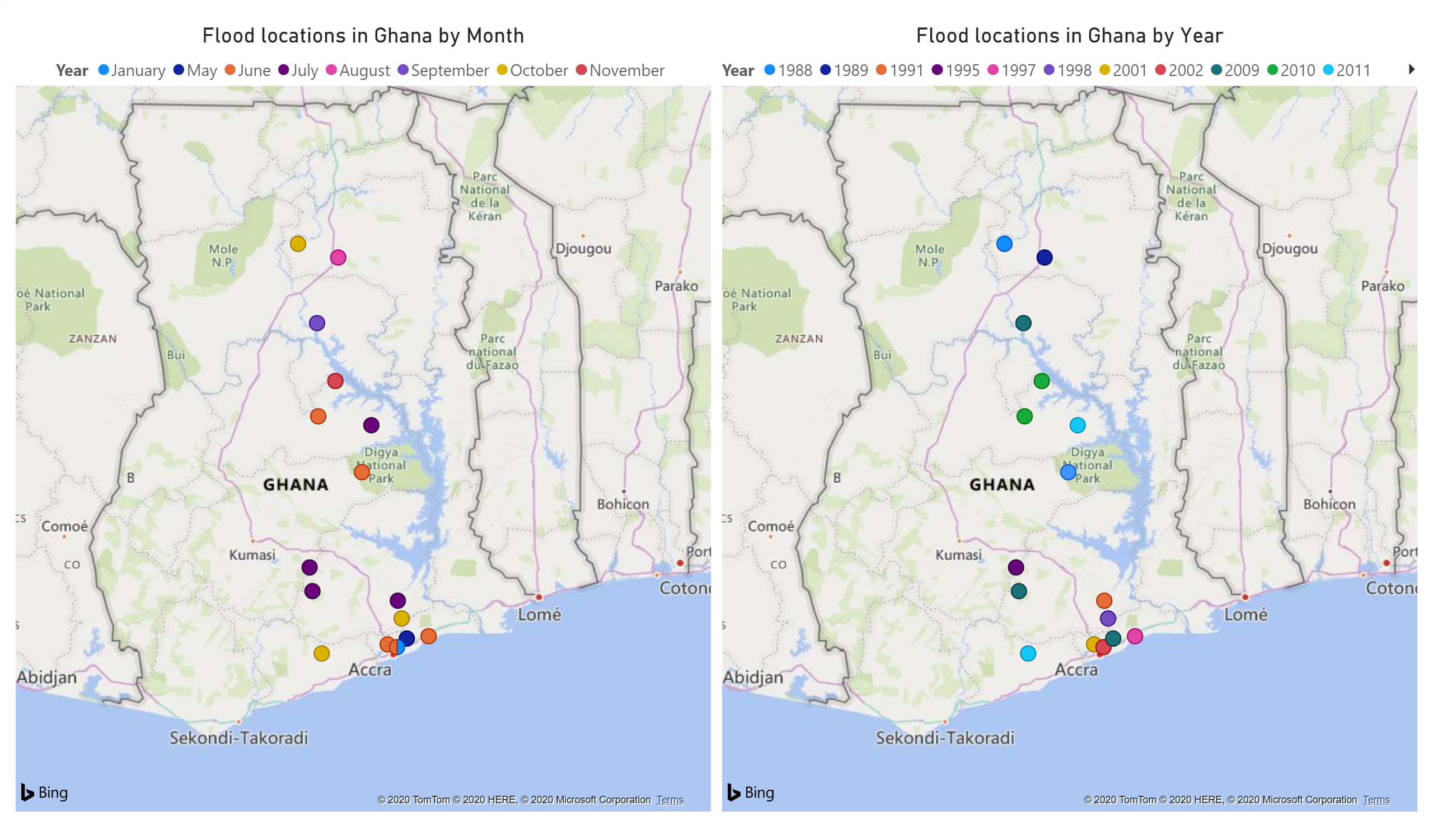
[Deep Dive on Solution]

Slide 16
[Summary and Call for Action]
Employ government and other agencies to help investigate other causes/factors of flood.
Farmers can also take advantage of our results.

